Slide 1
AIM – Southern
Pritha Mehra
April 2018

Slide 2

Agenda
Informed Delivery
Informed Visibility
Enterprise Payment
Move Update
Full Service
eInduction
Seamless Acceptance
Integrated Help Desk

Slide 3
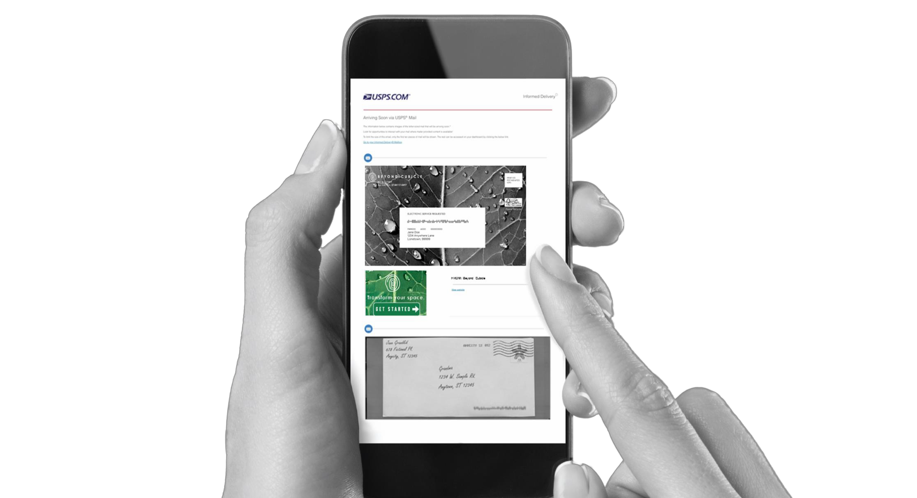


What is Informed Delivery?
e
Informed Delivery users receive scanned images of the exterior of incoming letter-sized mailpieces (processed through automated
equipment).
Images are available via email notification, online dashboard, or
mobile app.
You signed up yet?
Visit informeddelivery.usps.com
If a mailer participates in Informed Delivery, supplemental content, referred to as “interactive campaigns,” will be shown (for Letters or Flats).
Interactive campaigns include custom images and a URL that directs the user to a digital experience.
Notes:
• Informed Delivery provides eligible residential consumers with the ability to digitally preview their household’s mail arriving soon
• These previews are available via email notification, online dashboard, or mobile app – offering users access to their mail anytime, anywhere, even while traveling.
• There are two types of content that you might see in an Informed Delivery notification: (1) grayscale images of mailpieces and (2) interactive campaigns.
• The grayscale images shown here represent scanned images of the exterior, address side of incoming letter-sized mailpieces. This is what users see most frequently.
o It is important to note that not all letter-sized mailpieces are imaged; mailpieces must have a valid Intelligent Mail® Barcode (IMb®) and be processed on USPS® automation equipment to be imaged.
o It’s also important to note that Postal Service takes the privacy of mail very seriously. Consumers’ personal information is protected and the scanned images show only the outside of letter-sized mail. The inside contents are not imaged.
• The color content shown here represents what users will see if a business mailer chooses to conduct an Informed Delivery interactive campaign.
o If a mailer participates in Informed Delivery, supplemental content that they
3
provide will be shown in place of or alongside their grayscale
image.
o Interactive campaigns include custom images – known as
Representative and Ride-Along images – and a target URL that can direct the user to a digital experience, such as a website landing page.
• We’ll discuss the elements of Informed Delivery interactive campaigns in more detail later in this presentation.

Slide 4
Informed Delivery Statistics
8.5M
Registered Users
297
Participating Brands*
72.5%
Average Email Open Rate
1.5%
Average Click Through Rate
45%
Previously Never or Infrequently looked at the mail

Slide 5









What Type of Data is Shared?
Informed Delivery provides organizations with insights into the following:
Density and Email Statistics
The number of users and the percentage of users who elect to receive Informed Delivery emails
Open Rates
The number and the percentage of emails opened during an Informed Delivery campaign
Click-Throughs
The number and percentage of click-throughs – when a user interacts with digital content
17
Notes:
• Informed Delivery provides participating mailers with data reports that include information regarding:
o The number and percentage of campaign-related emails generated from the number of physical pieces. All Informed Delivery email subscribers in a household are included in this metric.
o The number and percentage of instances where a sent email was opened.
o The number and percentage of click-through generated from emails or the consumer dashboard.

Slide 6
How Can a Mailer Participate?
Pre-Campaign
Campaign
Post-Campaign
Plan your campaign
Prepare Mailing
Provide mailing details
Induct your mailing
Analyze and gather insights
Determine the type of campaign to conduct and create your mailing list(s)
Provide campaign elements to USPS such as campaign start and end dates, the Mailer ID (MID), IMb Serial Number range, custom image(s), and a URL
View the results of your campaign, including email open rate and number of click-throughs
19
Notes:
• Virtually any organization can conduct a campaign if their mailpieces are automation compatible and contain a valid IMb.
• Brands, MSPs, and agencies have all submitted campaigns to-date.
• While many people may be involved in the development of an Informed
Delivery campaign, including gathering necessary elements and content (e.g. the MID, IMb®/Serial Number range, start/end dates, images, URL, etc.), one person must submit the campaign file with all required elements.
• Campaign reports can be shared with multiple parties, though.
• The lifecycle of an Informed Delivery campaign involves five steps for
mailers:
o Plan your campaign – Determine the type of campaign to conduct
and create your mailing lists – separating them as necessary if
multiple campaigns will be run at the same time.
o Prepare the mailing – Prepare your hardcopy mailing as you
would regularly. No additional steps are required to conduct an
Informed Delivery campaign.
o Provide mailing and campaign details – Provide campaign
elements, such as mailing dates, the MID used on the mailpiece or
the MID and serial number sequence, custom images, and a URL. o Induct your mailing – No additional steps are required here to
conduct an Informed Delivery interactive campaign.
19
o Analyze and gather insights – View the results of your campaign, including email open rate and number of click-throughs.

Slide 7
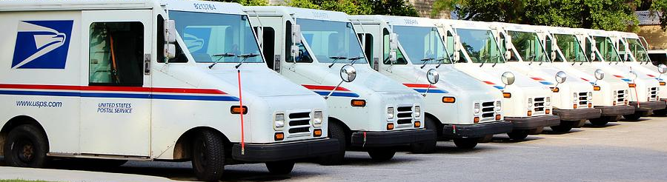
What is
Informed Visibility?




Event-Driven Internal Measurement of Mail
Near
Real-Time Service Performance Diagnostics
Mail Inventory Management of Mail and Packages
Predictive Workloads on Mail and Packages
End-to-End Tracking of Mail and Packages
Ease of Use
Near, real-time enterprise system that will be the single source of all mail visibility information.
Leverages data to provide business intelligence for USPS and the Mailing Industry, delivering:
Notes:
What is Informed Visibility (IV) you ask?
IV is a robust enterprise system that provides near real-time information available to both USPS and industry users.
The data intelligence collected and provided by IV can be accessed via the internal or external web applications and the data delivered can be leveraged to provide users with:
Event-driven internal measurement of mail
Near real-time service performance diagnostics
Mail inventory management of mail
Predictive workloads on mail
End-to-end tracking of mail
and, is easy to use

Slide 8


Mail Tracking & Reporting
Provides mailers visibility of letters and flats and their aggregates (bundles, handling units and containers)
Leverages
Nesting
Associations
Creates Assumed Handling Events
gap
Creates Logical Handling Event
Fills
Visibility
Gaps
gap
gap
IMb Tracing for Pieces and Bundles
Bundle Visibility
PostalOne! Container and Tray Visibility
Consolidates Mail Tracking into a Single System

Notes:
The Informed Visibility Mail Tracking & Reporting application provides visibility of letters, flats, bundles, handling units, containers, and transportation to mailers.
Mail Tracking & Reporting consolidates existing mail tracking services into a single system.
Today, mailers use IMb Tracing® for piece visibility and PostalOne!® for container and tray visibility. These existing tracking capabilities will be migrated to IV.

Slide 9














BEFORE
Enterprise Payment System (EPS)
ENABLED PRODUCTS/SERVICES
AFTER
Commercial Products + Services
Post Office
CAPS
Commercial Products + Services
ACH Debit
ACH Debit
PO Boxes
Post Office
PO Boxes
Address Quality Services
NCSC
CAPS
Address Quality Services
FUTURE PRODUCTS/SERVICES
Enterprise
Payment System
Stamps/
Packaging
NCMS
Stamps/
Packaging
Commercial Shipping Products
ACH
Debit
Commercial Shipping Products
CAPS
Trust Account
Express Mail
Corporate Accounts
ACH Debit
FedWire
ACH Credit
Post Office
CAPS
Express Mail
Corporate Accounts
Trust Account

Slide 10
Why EPS?
Enterprise Payment System (EPS)
ENABLED PRODUCTS/SERVICES
AFTER
Commercial Products + Services
Pay for all Products and Services with one account
Manage accounts online
Establish permits online
Manage postage spent
Convenient payment options
ACH Debit
PO Boxes
Address Quality Services
FUTURE PRODUCTS/SERVICES
Enterprise
Payment System
Stamps/
Packaging
Commercial Shipping Products
Trust Account
Express Mail
Corporate Accounts
FedWire
ACH Credit

Slide 11
Commercial Mailings on EPS
Eligible Products/Services | Eligible Submission Methods | Eligible Permit Types | Eligible Transactions | Products & Services Coming Soon!
PO Box, Caller & Reserve Services (EPOBOL) Address Quality Products (AEC, AECII and ACS) Priority Mail First- Class Mail, Letters, Cards, and Flats First-Class Package Service USPS Marketing Mail, Letters, Flats, and Parcels Parcel Select Media Mail Library Mail Bound Printed Matter Periodicals International Products Business Reply Mail (BRM) Every Door Direct Mail (EDDM) BMEU | Business Mail Entry Unit (BMEU) hard copy eDoc (Mail.dat/Mail.XML) Postal Wizard Intelligent Mail small business (IMsb) Tool | Permit Imprint Metered Pre-cancelled Stamps Periodicals (CPP/PP) Postage Due Business Reply | Postage Statement Processing (Domestic & International) Adjustments Mail Entry Postage Assessment Reversals Refunds (including Value Added Refunds (VAR)) Deposits Transfers Fee Payments Postage Due FOIA Requests | Electronic Verification System (eVS) Enhanced reports coming Spring/Summer 2018 Intelligent Mail barcode Accounting (IMbA) Merchandise Return Service (MRS) Official Mail Accounting System (OMAS) Parcel Return Service (PRS) PC Postage Pickup On Demand and Package Intercept after (PFSC) Premium Forwarding Service Commercial (PFSC) Scan Based Payment (SBP) Share Mail

Slide 12
EPS Products & Services
Legacy | Current State - EPS
Deposit funds in person at assigned Post Office Checks, Cash, Credit Card or Money Orders to fund permit mailings Mail at multiple sites, maintain permit balances at each assigned Post Office | Use a single payment account for all permits; if mail at multiple sites ACH Debit: Establish an ACH Debit account to have funds withdrawn directly from bank account Electronic Funds Transfer: Pre-fund mailings via an electronic funds transfer (Fedwire or ACH Credit) Retail Deposit: Deposit checks, cash or money orders at any Post Office Mobile Deposit: Deposit a check remotely using Mobile Check Capture *coming soon
PO Boxes Online limited to 5 PO boxes/services ACH Debit is not supported as a payment method Individual renewals and account management at local offices | Consolidated Online Management Open, close, view, pay fees and renew all PO Boxes, Caller and Reserve Services Manage multiple local accounts from a single application Easy Renewal Renewal/expiration notifications sent electronically *Coming Soon* - Consolidate payment dates for boxes opened at different times
Customer submits paper application forms for ACS or AEC NCSC generates daily or monthly invoices & manually processes payment | Electronic invoice transactions Consolidated transaction reporting available from EPS
Commercial Products + Services
PO Boxes
Address Quality Services

Slide 13





Commercial Mailings on EPS Account Setup
Get Ready!
Create BCG Account
Request EPS
Create EPS Account
Set-up
Payment
Link Permits/
Publications
Choose the best payment option for your organization
Get a list of all your active permits
Register for a Business Customer Gateway (BCG) Account
Customers already registered skip to the next step
Contact your local Business Mail Entry Unit to request participation
Access the Enterprise Payment System using the hyperlink and invitation code.
Create an Enterprise Payment Account
Set up the selected payment option:
ACH Debit or Trust via EFT, Retail Deposit or Mobile Deposit
Link your mailing Permits to your EPA
Notes:
1. Request invitation code to participate in EPS
2. Create BCG account if not registered
3. Access EPS via BCG
4. Create an EPA
5. Activate a payment method
6. Link products and services

Slide 14




Commercial Mailings on EPS – Transactions
Submit Postage Statement
Present
Mailing
Process
Mailing
Finalize
Mailing
Withdraw
Payment
View Mailing Reports
Submit postage statement* electronically using mail.dat, mail.xml or postal wizard, or via hardcopy at BMEU
Present mailing
at USPS facility
Action recorded in PostalOne!
Payment transaction
sent to EPA
Payment withdrawn from EPA
Mailing reports viewable in BCG and EPS
Permit/publication number field: Enter permit/publication number in eDoc
Account number field: Optional, but must match the account number linked to the permit number
Mail Anywhere: EPA number will replace National account number
Notes:
1. Request invitation code to participate in EPS
2. Create BCG account if not registered
3. Access EPS via BCG
4. Create an EPA
5. Activate a payment method
6. Link products and services

Slide 15
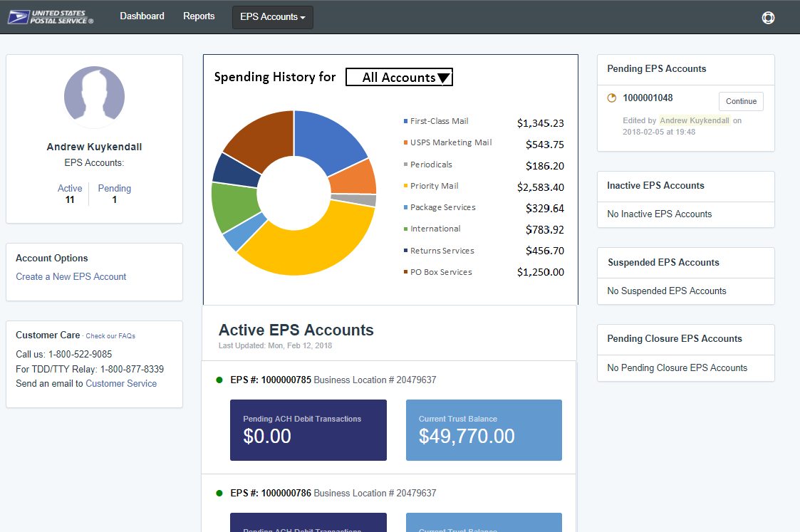
Customer Dashboard
Commercial Mailings on EPS – Reports
Customer Dashboard provides a quick glance of all EPS accounts
View the real-time total of pending ACH debit transactions sent to the bank at the end of the day, as well as the Trust Balance
Pending Accounts where the account setup process needs to be completed are viewable as well
Notes:
Two general routes:
1 - Select an Account (by clicking one of the boxes on the screen or using “EPS Accounts” dropdown on top menu bar) – this will take you to Account Summary page
2 - Select the “Reports” link from top menu bar to see a list of available reports.

Slide 16
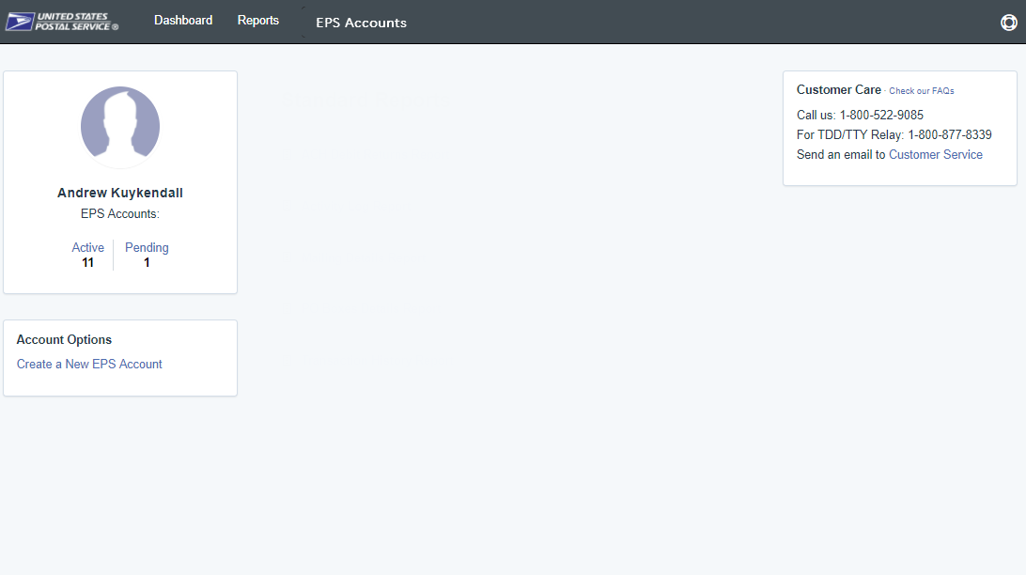
Standard Reports
Commercial Mailings on EPS Reports
Access to various data providing information on:
  Transaction History
  USPS Products & Services Transaction Details
  All Mailings
  Transactions by Mail Class
  PO Box Services
  Address Quality
  User Account Activity
Reports
Transaction History
USPS Products & Services
  Commercial Mailing & Shipping
  PO Box Services
  Address Quality
ACH Debit Returns
User Activity Log

Slide 17
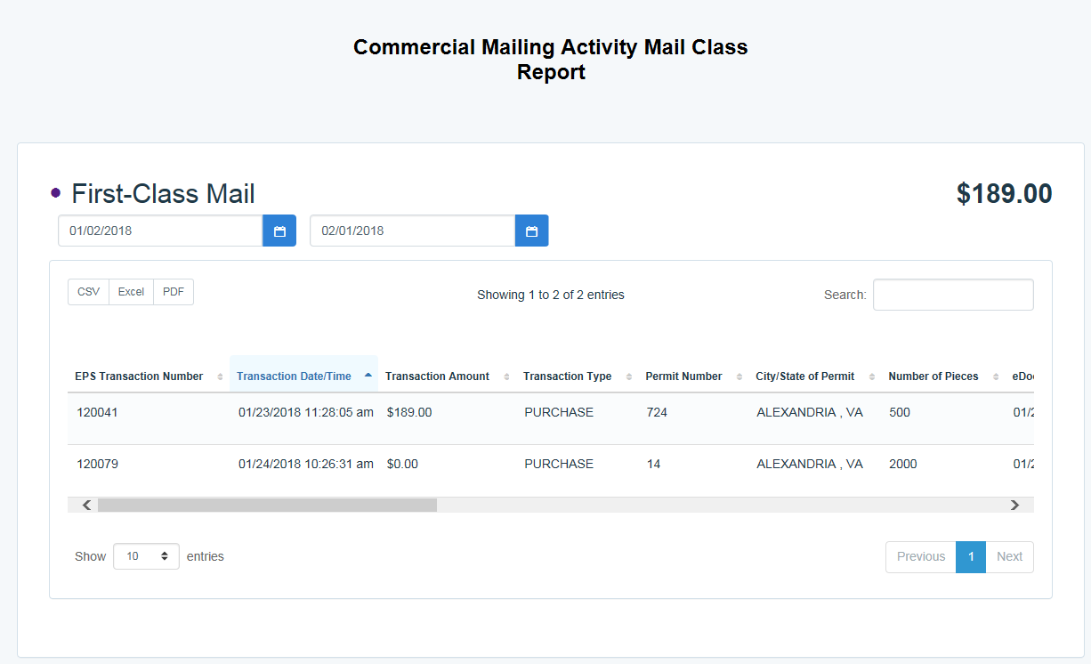
Commercial Mailings on EPS – Reports
Commercial Mailing and Shipping Details Reports
Commercial Mailing and Shipping Details
The Commercial Mailing and Shipping Details Reports show all transaction details for the selected Mail Class(es). The report may be filtered to show all, one, or a user selected combination of mail classes.
All Mailing & Shipping Products
Notes:
EPS Transaction Number
Transaction Date/Time
Transaction Amount
Transaction Type
Permit Number
City/State of Permit
Number of Pieces
eDoc Mailing Date
Postage Statement Number
EPS Account Number
Job ID
Customer Reference ID
Permit Holder CRID
ZIP of Verification
Publication Number
User License Code
Class
Number of Copies
Spoilage
EPS Account Nickname

Slide 18
Informed Visibility – Payment
EPS Data Distribution through Informed Visibility will be available Summer 2018
Customers may subscribe to have data pushed to their Secure FTP (SFTP) server or available for online download
Customers may select the following, based on their preferences
Category | Preference Options
File Format | Delimited JSON
Target | Define SFTP Location Select online download option
Source Frequency | Define the quantity of data in each batch Daily, Weekly, Monthly
Frequency | Define how often you would like to receive the data Can be every minute to every 31 days
Email Notifications | User may create list of contacts to be notified when new data is posted/available for download

Slide 19
Informed Visibility – Payment
The data elements below will be available for each of the following groups: Transaction, Mailing Details, Return Details, PO Box Details, Address Quality Details
Transaction
Transaction ID
Transaction Date
Transaction Type
Transaction Amount
Description
Detail
Original Transaction ID
EPS Account Number
EPS Account Nickname
Business Location
Payment Method
Payment Method Nickname
Mailing Details
Job ID
eDoc Mailing Date
Postage Statement Mailing Date
Mail Arrival Date
PostalOne Transaction ID
Customer Reference ID
User License Code
Mail Class
Number of Pieces
Number of Copies
Spoilage
Product Number
Product Type
Refund Type
Refund Reason
Refund Comment
CAPS Account
CAPS Account Name
Customer National Account Number
Customer Name
Reversed Transaction Type
Return Details
Mail Class Code
Mailer ID
Base SKU
Package Scan Group ID
PIC
Service Type Code
PO Box Details
Box City
Box State
Box Number
Box Zip
Box Size
Box Renewal Date
Address Quality Details
NCSC Customer Number
NCSC Product
NCSC Order Reference Number

Slide 20
Enterprise Payment Services – Resources
  PostalOne! Help Desk
Support customers with EPS setup & use
  Postalone@usps.gov
  800.522.9085
  Email questions
  Support customers with migration preparation
  USPSPayment@usps.gov
  Contact your local BMEU
  Support customers with EPS setup and use
  BMEU locator
  PostalPro
  Provide online reference materials
https://postalpro.usps.com/eps
Ready?
Submit “EPS Request” via email: USPSPayment@usps.gov
*Include BCG username for BSA, email address & CRID(s)

Slide 21
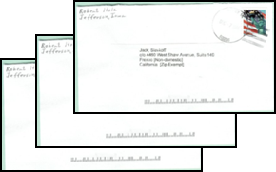

Move Update Standard Compliance
Determine Eligible Mail Class
Select Approved Update Method
Update Address List
First-Class Mail presorted or automation prices
USPS Marketing Mail
Mailers who present mixed mailings that pertain to at least one of these categories are still subjected to the Move Update standard
Mailers must use at least one of the USPS
approved methods to update address list
  NCOALink
  NCOALink MPE
  ACS: SingleSource, Traditional, OneCode,
  Full-Service
  ASE
Mailers must reconcile their mailing address list within 95 days prior to
the postage statement finalization date with one of the Postal Service-approved methods or an assessment may apply
Reduce Undeliverable As Addressed (UAA) mail
Ensures mailpieces reach intended recipients
Notes:
Compliance with the Move Update standard is a basic eligibility requirement for USPS Marketing Mail and First-Class Mail letters and flats automation and presort rates. The goal of this requirement is to reduce Undeliverable As Addressed (UAA) mail by ensuring that mailers are updating the addresses in their mailing lists on a regular basis. Improved address quality ensures that mailings reach their intended recipients and reduce mail processing and delivery costs for the USPS. The USPS offers for approved methods to receive updated address information. Once the updated address information is received mailers should update their address lists within 95 days of postage statement finalization date.

Slide 22


Move Update Approved Methods
To assist mailers in meeting the Move Update Standard USPS offers 4 approved methods
Pre Mailing: Updating mailing address list before you mail | NCOA^{Link} National Change of Address Link | Verifies a mailer submitted mailing address list against the USPS NCOA database
 | NCOA^{Link} MPE National Change of Address Link Mail Processing Equipment | Uses Mail Processing Equipment (MPE) technologies to match the printed address from a mailpiece against the NCOA Database
Post mailing: Updating mailing address list after you mail | ASE Ancillary Service Endorsements | Allows mailers to receive COA information via hardcopy notice provided by USPS Mailer must print an endorsement on mailpieces
 | ACS* Address Change Service | Allows mailers to receive COA information and other reasons for non-delivery electronically *Free for Full-Service and basic automation/non-automation mailers
Notes:
Currently, mailers can meet the Move Update requirements by using USPS-approved methods:
National Change of Address Link, or NCOA^{Link}
The first primary method that we will examine is National Change of Address Link, or NCOA^{Link}. NCOA^{Link} is an USPS approved pre-mailing address correction service that a mailer uses to process their mailing list through the USPS National Change Of Address (NCOA) database to determine if a change of address is on file. If a match to a change of address is found, it will update to the new address prior to mailing. NCOA^{Link} is considered the best and most effective method to comply with the Move Update Standard because the service can identify and correct the mailing address before mailing, avoiding undeliverable mail beforehand. In addition, NCOA^{Link} is applicable for all mail classes.
National Change of Address Link Mail Processing Equipment, or NCOA^{Link} MPE
The National Change of Address Link Mail Processing Equipment, or NCOA^{Link} MPE, is a second Move Update method and is a subset of NCOA^{Link}. This product uses Mail Processing Equipment technologies to match the printed address from a mailpiece against the National Change of Address Database and to update the address by printing the change-of-address barcode directly on the mailpiece. Keep in mind that NCOA^{Link} MPE is not a common Move Update method; typically, larger mailers using barcode readers and optical character readers use this method. NCOA^{Link} MPE requires mailers to submit physical mailings, where the new address barcode is sprayed on the mailpiece when a change-of-address record is identified in the NCOA database. Reports on change-of-address information are available upon request for the mail owners.
Address Change Service, or ACS
The third method for satisfying the Move Update standard is Address Change Service, or ACS. ACS is a post-mailing address correction service that allows mailers to receive change-of-address (COA) information and other reasons for non-delivery electronically. Think of Address Change Service as an electronic, automated version of the Ancillary Service Endorsement. Note, that Full-Service ACS is available free of charge for qualifying Full Service mailers. As of January 2018, the no-fee Full-Service ACS was extended to qualifying Basic automation and non-automation mailpieces for mailers who enter at least 95% of their mail as Full-Service in a calendar month.
Ancillary Service Endorsement, or ASE
The fourth and final method for satisfying the Move Update standard is Ancillary Service Endorsement, or ASE. ASE is a post-mailing service that allows mailers to receive change-of-address or reason for non-delivery information via hardcopy notice provided by USPS if the mailer prints an endorsement on a mailpiece.
If a mailpiece is undeliverable, USPS will forward, return or dispose the mailpiece depending on the choice of endorsement. There are four endorsement options under ASE which the mailers may use: Address Service Requested, Return Service Requested, Change Service Requested, and Temp-Return Service Requested. Additional fees may apply to certain endorsements.
Mailers using “Temp-Return Service Requested” endorsement should understand the option is not available for Standard Mail to comply with Move Update. Furthermore, “Change Service Requested” endorsement cannot be used as a stand-alone method to comply with Move Update; instead, this endorsement must be used in conjunction with Address Change Service method.

Slide 23
Address Correction Service
The Mailer Indicates how the USPS
should handle the UAA mailpiece
Mailpiece Disposition Options
Address Correction Option
The Mailer indicates how the USPS
should provide the COA information
Address Service
Forward if possible; provide change of address information electronically. All other UAA mail returned to sender.
Full-Service ACS
Receive electronic notification of customer change-of-address or reason for non-delivery for Full-Service pieces
One Code ACS
Receive electronic notification of customer change-of-address or reason for non-delivery for non-Full-Service pieces
Return Service Requested
All UAA mail is returned to sender
Change Service Requested
Option 1: All UAA mail is discarded.
Option 2: Forward if possible, all other UAA mail is discarded.
SingleSource ACS
Receive both Full-Service ACS and One Code ACS records in a single shared file
Change Service Requested is now Green and Secure
USPS recycles or securely destroys UAA mailpieces based on mailer’s indicated preference
Notes:
Mailers have three choices when determining mailpiece disposition; Address Service Requested, which forwards the mailpiece if a valid change of address is on file and returns all other UAA mail to the sender. Return Service Requested, which returns all mailpieces to the sender and Change Service Requested, which allows the USPS to recycle or securely destroy mailpieces that are UAA, unless forwarding is requested. All address change information is provided to the mailer electronically through Full-Service ACS, One Code ACS, or Single Source ACS. Full-Service is accessed through the Business Customer Gateway and contains change of address or nixie information for all Full-Service pieces, One Code provides information for basic mailpieces, and SingleSource provides information for all notices. The new Green and Secure Program includes Change Service Requested STIDs and Secure Destruction STIDs.

Slide 24


Green & Secure Program
Without Secure Destruction
First-Class Mail & Marketing Mail
Example: STID 504
Change Service Requested
Option 1: All UAA mailpieces discarded
With Secure Destruction
First-Class Mail ONLY
Example: STID 520
Without Secure Destruction
First-Class Mail & Marketing Mail
Example: STID 510
Option 2: Forward if
possible, all other UAA
mail is discarded
With Secure Destruction
First-Class Mail ONLY
Example: STID 335
Allows USPS to recycle or securely destroy UAA mailpieces that cannot be forwarded
  Reduces additional handling costs for USPS
  Excludes all mailpieces bearing STID from Move Update Census assessments
Does NOT alleviate the mailer from meeting the Move Update requirement
Notes:
The costs to the USPS of handling UAA mail are substantial, with the cost for returning this mail to the sender being the highest, at $0.427 per piece for all mailpiece shapes. Discarding UAA mail is the least expensive, at $0.11 per piece. The Green and Secure program reduces USPS’ additional handling costs by allowing us to recycle or securely destroy UAA mailpieces for First-Class Mail and USPS Marketing Mail letters and flats.
To participate in Green and Secure, the mailer must be enrolled in ACS. Then the mailer would decide how they would like the USPS to dispose of their UAA mailpieces.
Green Disposal:
If the mailer would like for the USPS to recycle their First-Class and/or USPS Marketing Mail, the mailer would select the Change Service Requested STID. If they would like for the USPS to recycle ALL mailpieces, the mailer would select option 1. If they mailer would like for the USPS to forward qualifying mailpieces -- the mailpiece must correspond with a Change of Address (COA) record that is less than one year old -- and recycle the remaining mail, the mailer would select option 2.
Secure Destruction:
The options, destroy all mailpieces or forward qualifying pieces and destroying remaining mailpieces, are the same for Secure Destruction. The only difference is the USPS will securely destroy – shred – the mail. If they would like the mailpieces securely destroyed by the USPS, the mailer would select the Secure Destruction STID.
The goal of the new method is to both reduce the volume of return-to-sender mail and to provide an additional method for mailers to use to avoid address quality assessments for all mailpieces bearing a the appropriate STID.

Slide 25
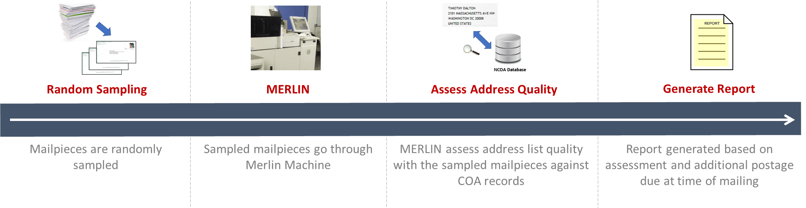
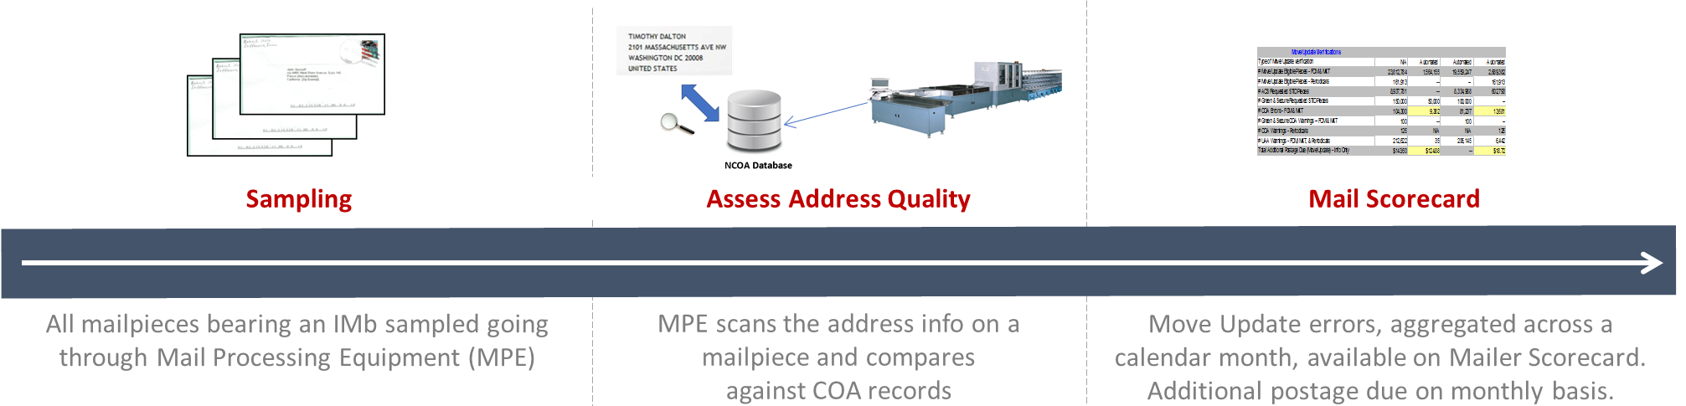
Move Update Validation (Old vs New)
MERLIN Method
*NEW* Census Method
Notes:
Effective March 1 the USPS will implement a new method to determine Move Update Compliance called the Census Method. To be measured under the Census Method mailers must have submitted at least one Full-Service Mailing, all mailpieces bearing a unique IMb included in eDoc will be validated by comparing address information to the USPS Change of Address database, any mailpiece that has a valid change of address on file that has not been updated within 95 days of postage statement finalization will receive an error. Results are aggregated across the calendar month and displayed on the Mailer Scorecard and any mailpieces exceeding the established .5% threshold will be assessed the $.08 fee. Assessments are generated on the 11th day of the following month.

Slide 26
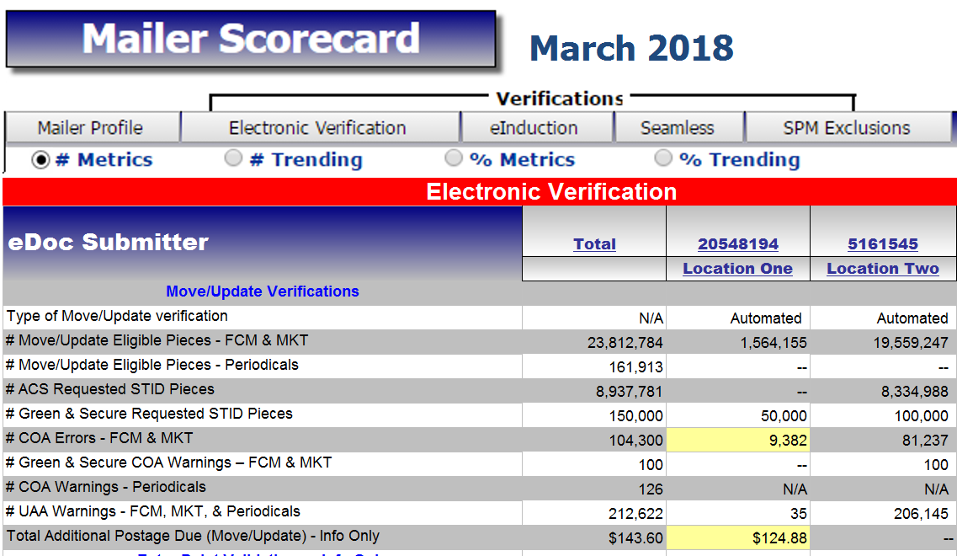
Mailer Scorecard (Move Update)
Indicates if Move/Update data was evaluated by manual or automated verification for the CRID for the selected month
# presort or automation First Class and USPS Marketing Mail pieces (letters, flats & cards)
# Move Update eligible periodical pieces (Info Only – ineligible for assessment)
# pieces that utilized a service type code for address correction service (includes Green & Secure pieces)
# pieces that utilized a service type code for Green & Secure
# First Class and USPS Marketing Mail pieces that were eligible for Move/Update and received a change of address error.
# Green & Secure pieces that received a change of address warning
# Periodical mail pieces that were eligible for Move/Update and received a change of address warning
# First Class, USPS Marketing, and Periodical mail pieces that received a warning that the mail piece was undeliverable as addressed
Move Update Error % is calculated by dividing the # COA Errors – FCM & MKT by the # Move/Update Eligible Pieces – FCM & MKT
Additional Postage Due is the number of errors above the 0.5% threshold multiplied by $0.08
The amount of additional postage that may be assessed based on the change of address errors that were identified for the CRID for the month above the 0.5% threshold
Notes:
The results of the Move Update Census method are displayed on the electronic verification tab of the mailer scorecard and provides information to assist you in identifying errors as well as information regarding Periodicals, Green and Secure, and UAA warnings.

Slide 27
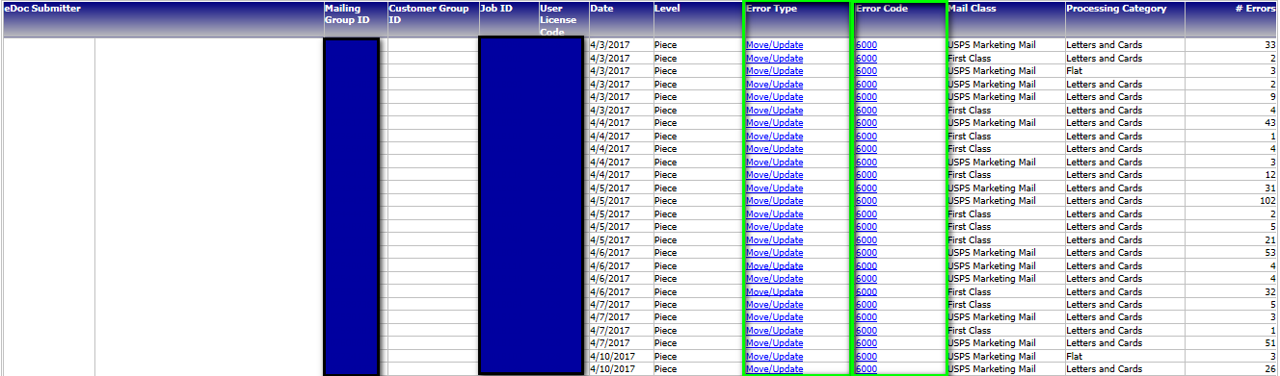
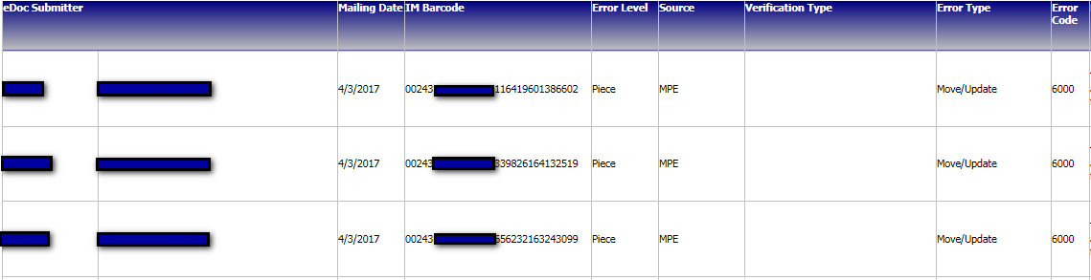
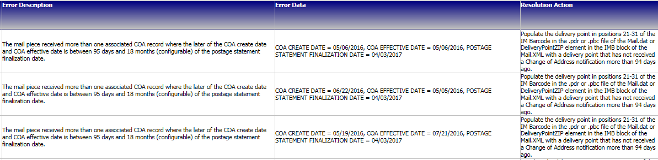
Mailer Scorecard (Census Method Drill)
4. Click on Error Type or Error Code link for Job Level Details
5. Click on Error Type or Error Code link to get to Piece Level Detail
6. Detailed Piece Level Error details populate and error Description/Error Data/ and Resolution Action appear to assist in diagnosing and correcting errors.
Notes:
The drilldowns include errors at the individual error codes and job level, and piece level information with the error description and the resolution to fix the error.

Slide 28
Move Update: Free Address Correction Service
*Census Benefit
Free Address Correction Service*
March 2018
Quarterly Measuring
Basic automation
/non-automation requirements
Feedback
Residual ACS records provided for free to qualifying mailers that submit over 95% Full-Service volume
If eDoc submitter falls below threshold a notification will be given prior to the next billing cycle
Unique IMb in eDoc
Full-Service or OneCode ACS STID
Valid by/for identification
Notices will be provided through Full-Service, One Code and SingleSource feedback
Notes:
As an added benefit to mailers USPS is extended free ACS notices to basic automation and non-automation mailpieces if you meet the following requirements. The eDoc submitter must present at least 95% Full-Service Volume, the Mailpiece must contain a unique IMb included in eDoc, you must use a FS or OneCode ACS requested STID and include the proper mail preparer and mail owner information (By/For) in the edoc. All address correction notices will be provided through Full-Service, OneCode and SingleSource ACS feedback. Qualification is measured on a Qua

Slide 29
Automated Acceptance Programs
Full Service
eInduction
Seamless Acceptance
Intelligent Mail barcodes on all mailpieces, handling units, and mail containers
End to end visibility into the mailstream
Simplifies the induction of drop shipments and expedited plant load mailings
Verify payment and preparation of commercial mail containers
Automates the entry and verification of commercial mailings

Slide 30
Full Service
  Benefits
    Reduce Costs
      Receive additional per piece discount on automation mailings
      Eliminate permit fees
      Use the same permit at any location
    Accurate Delivery
      Address Correction on Full-Service pieces
    Monitor Service
      Start-the-Clock on Mail Entry Visibility and tracking
  Requirements
    Apply unique IMb to each postcard, letter, and flat
    Apply unique IMtb to trays and sacks
    Apply unique IMcb to placards for containers
    Submit postage statements and mailing documentation electronically
      Mail.dat
      Mail.XML
      Postal Wizard

Slide 31
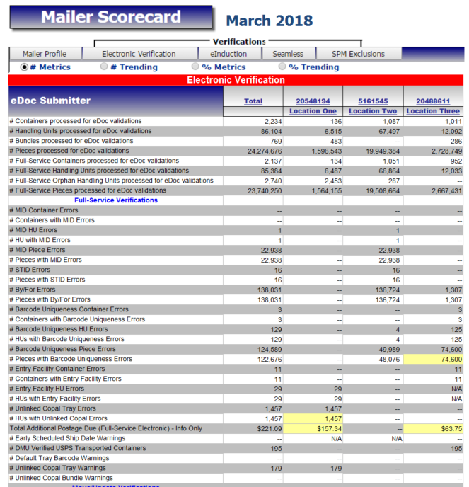
Full Service
Mailer Scorecard & Assessable Metrics
  Provides an overview of the number of Full Service containers, handling units, and pieces
Error Type | Threshold
Container – Mailer ID | 2%
HU – Mailer ID | 2%
Piece – Mailer ID | 2%
HU – Unlinked Copal | 5%
Piece – STID | 2%
Piece – By For | 5%
Container – Uniqueness | 2%
HU – Uniqueness | 2%
Piece – Uniqueness | 2%
Container – Entry Facility | 2%
HU – Entry Facility | 2%

Slide 32


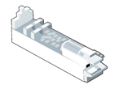

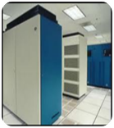
eInduction
eInduction streamlines the preparation and induction of drop shipments and expedited plant load mailings
70% of total plant-verified drop shipment (PVDS) containers are participating in the eInduction program
Prepare & Submit eDoc
eDoc Upload & Verification
Scan Container Placard
Induct Mail
Review Mail Quality Reports
Feedback Provided Throughout the Process
Use eDoc
Unique IMcB
Placard containers
Make appointment
Validate eDoc Records
Release paid containers
Verify payment
Verify entry location
Detect duplicate containers
Send scan data to PostalOne!
Additional post-induction verifications
Verification data shown on trend reports
Quality monitored across a month’s mailings

Slide 33
eInduction provides flexibility and supports mailers using special preparations/processes. Mailer transported volume is eligible for eInduction
Benefits of eInduction
  Mailer Transported, Destination Entry with Entry Discount
  Mailer Transported, Origin Entry, no Entry Discount
Continuous Mailers | Can register a MID as eInduction Continuous Allows induction prior to eDoc upload/postage payment Mailer agrees to pay all assessments
Drop Shipment Management System (DSMS) Mailers | DSMS mailers can use eInduction No paper PS Form 8125 for eInduction containers
Consolidators | Can upgrade mailer containers to eInduction ContainerManifestCreateRequest Mail.XML message
Misshipped Override | Mailer option USPS returns or accepts misshipped containers Potential additional postage assessment for accepted containers

Slide 34
eInduction uses mailing data, not manual checks or verifications to confirm mail quality
Measuring Mail Quality
Has the container been paid for?
Was the correct rate paid?
Create and deliver paper PS Forms 8125/8017
PostalOne! transmits payment status to entry point
Legacy Verification
Undocumented
Container is listed in an eDoc
Mishipped
Container is inducted at correct location
eInduction Verifications
Payment
Finalized postage statement exists for container
Entry Point Discount
Correct entry discount was claimed
Duplicate
Only one instance of container in last 45 days
Zone Discount
Correct zone discount was claimed

Slide 35
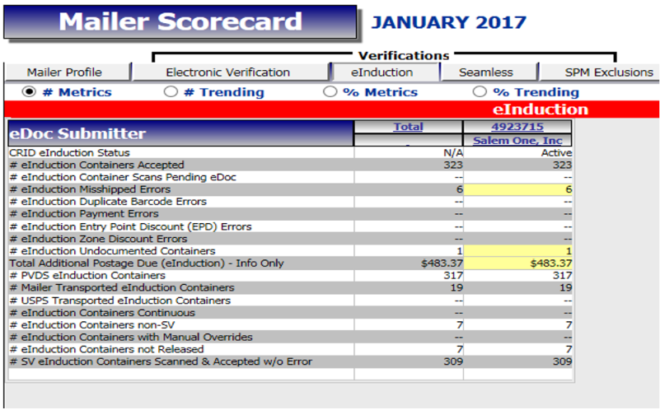
eInduction Mailer Scorecard
eInduction Tab
  Provides an overview of the number of containers on eInduction and number of eInduction verification errors over a calendar month
  View the results of eInduction verifications from Surface Visibility (SV) scanning performed on the dock and eDoc preparation
  Provides feedback on eInduction errors at the eDoc submitter CRID level
Mailer 1

Slide 36
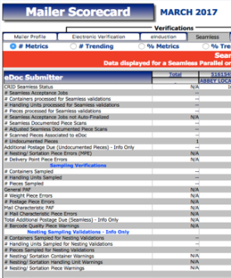


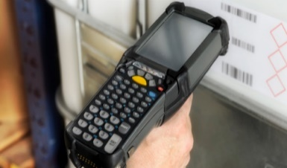


Seamless Acceptance
Seamless Acceptance provides mailers a streamlined process that offers transparency and trend-based reporting so mailers can improve their mail preparation efficiency.
30% of commercial mail volume is on Seamless.
Mail
Preparation
Finalize
Postage Statement
Mail
Acceptance
Mail
Processing
Mail
Verification
Generate
Reports
Feedback Provided Throughout the Process
Prepare Mailings with Intelligent Barcodes and eDoc
WHY?
Allows for data driven verification
Automatically finalize postage statement before verification using PostalOne!
WHY?
Allows for a longer mail production cycle and greater control over postage payment
Manually collect mailing information at the DMU or BMEU using handheld scanner
WHY?
Allows for the collection of weight,
postage payment, and mail characteristic data
Electronically collect mailing information using scans from MPE
WHY?
Allows to check almost every mailpiece for quality
Compare manual and electronic sampling data to eDoc information
WHY?
Allows for validation that correct payment has been made to USPS
View reports and drill down for more detail anytime during the month
WHY?
Allows mailers access to review errors, identify trends, and improve upon future mailings

Slide 37
Seamless Acceptance measures the quality of a mail preparer’s process over a calendar month to identify trends in mail quality issues rather than isolated poor quality incidents
Benefits of Seamless
Verifications are performed electronically, reducing complexity
Auto-finalization puts control of postage payment into the mailers’ hands
Longer mail production cycle
Control over mail release timing without USPS intervention
Allows for improved feedback and identification of trends
Standardized acceptance and verification process
Trend-based verifications measuring quality across a calendar month

Slide 38
Seamless Acceptance uses data from electronic Documentation (eDoc), manual sampling, and from Mail Processing Equipment (MPE) scans to confirm mailpieces have been paid for, were properly addressed, and were prepared properly.
Measuring Mail Quality
eDoc
Manual Sampling
Mail Processing Equipment (MPE)
Delivery Point Verification
IMb in eDoc contains an valid delivery point, based on reference data from AMS
Weight
Sampled weight consistent with weight included in eDoc
Nesting Sortation
Piece nesting in the same tray as defined in eDoc
Postage
Postage Payment Method and Postage Affixed consistent with eDoc
Undocumented
Scanned IMb included in eDoc (within the past 45 days)
Mail Characteristic
Processing category and mail class consistent with eDoc
Undocumented
Sampled IMb included in eDoc (within the past 45 days)

Slide 39
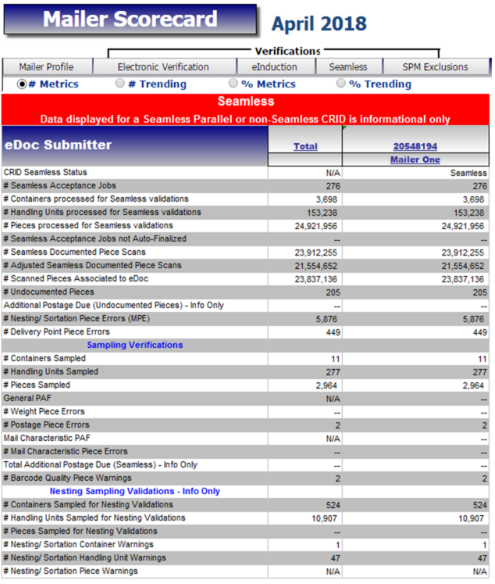
Seamless Mailer Scorecard
Seamless Tab
  Provides verification results compiled over each calendar month
  Tab broken into two main types of metrics
    MPE and eDoc
    Data from Sampling

Slide 40
USPS performs two types of sampling – Sampling & Nesting.
Manual Sampling Sampling
 | Seamless Sampling | Nesting Sampling
Eligible Mailings | Seamless mailings | Agnostic to Seamless status Performed at sites with potential service performance issues
Reason for Sample | Seamless sampling is necessary to verify attributes that will not be collected during automated mail processing Verify piece weight, postage, mail characteristic, barcode quality | Nesting sampling (tray to container) performed to validate the trays are nested on the correct container
Frequency/ Sample Selection | DMU – DMU dashboard displays how many samples must be performed BMEU – prompted at the clearance placard portion of a statement Randomizer tool used to select which containers Samples selected are job agnostic | 12 containers sampled per day Randomizer Tool used to select containers Samples selected are job agnostic
Invoice | Seamless mailers | Nesting Sampling warnings are never invoiceable

Slide 41

Overview
Integrated Help Desk
Strategic support for commercial mailers
  Enhanced customer experience
  Standardized answers through body of knowledge
  Multiple contact methods: 800 number & standard email
Concept pilot launched October 2017 in:
  Capital Metro: Capitol District
  Eastern: Northern Ohio
  Great Lakes: Lakeland
  Northeast: Northern New England
  Pacific: San Diego
  Southern: Dallas
  Western: Northland

Slide 42

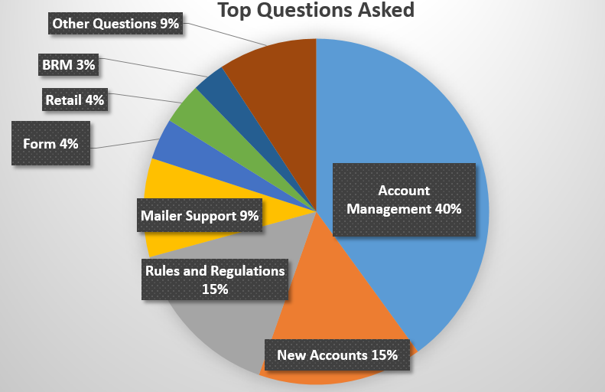
Integrated Help Desk
Offerings
Centralized tracking method for customer inquiries
    Unique ticket number
    Date and Time ticked opened/closed
    Specific issue, question or concern captured and categorized
Trend Recognition
  Identify gaps in the current online solutions and make improvements
    Develop FAQs to commonly asked questions
    Create a ChatBot to generate answers and provide seamless transition
    to a live agent needed
    Redesign BCG to incorporate common questions asked
Identify automated and non-automated solutions to enhance customer experience

